Slide 1
VIVADO
TETRIS
By Carly Butler, Leah Jones, Sarah Koesema, Hieu Nguyen
Notes:
Carly

Slide 2
GOAL/MOTIVATION
We are creating a Tetris game that includes both VGA and FPGA.
Why?
We all love playing simple games on our phone and thought it would be a fun idea to implement a similar keyboard game.
Who?
Tetris is not only a fun game, but studies have shown it also can help improve cognitive thinking and individuals with lazy eye.
Notes:
Hieu

Slide 3
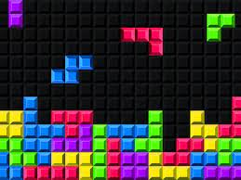
PLAN
Implement the basic template of the game “Tetris” onto the FPGA which would be taking inputs from a keyboard. Then displaying it on a screen monitor
Features
Moving the block left and right
Soft drop and hard drop
Clearing the line when full
Displaying the current score and top score if there is time
Notes:
Sarah

Slide 4
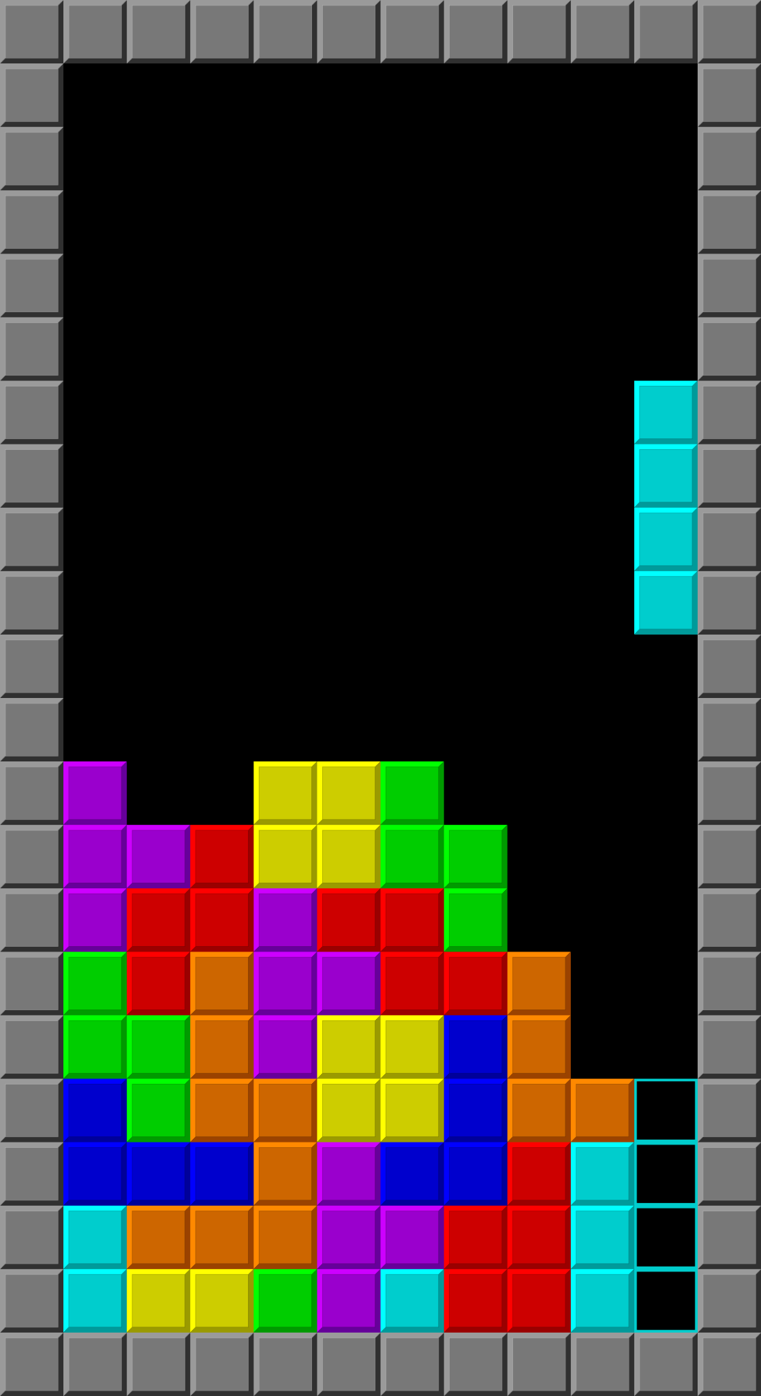
Functionality
Our design is supposed to create a fully functional and interactive Tetris game on an FPGA board.
Movement
Horizontal shifting and 90° rotation with keyboard controls
Scoring
Adding points for full line clears and increasing difficulty as score increases
Visual Display
Use VGA for grid and block representation on monitor
User Interface
Show score on Seven Segment Display
Notes:
Leah

Slide 5
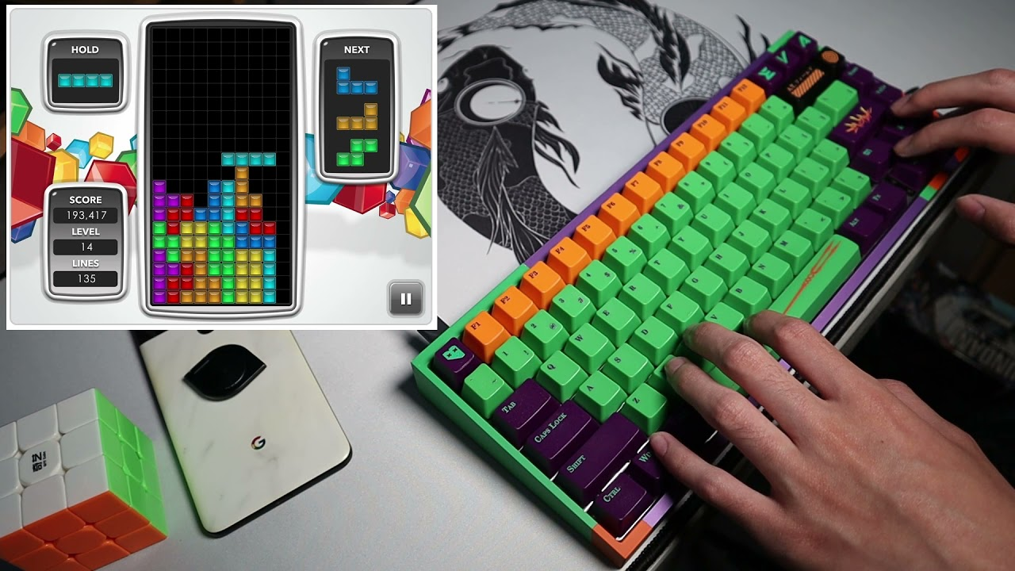
Specifications
What it’s Supposed To Do
Display
Render a Tetris game screen that’s both appealing and responsive
Timing
Manage clock cycles efficiently for smooth gameplay and block rotations
Gameplay
Implement falling blocks, drop, rotation, and movement
Constraints
Time
Group Scheduling
Lab Restrictions
Resources
VGA
Keyboard to FPGA
Notes:
Leah

Slide 6
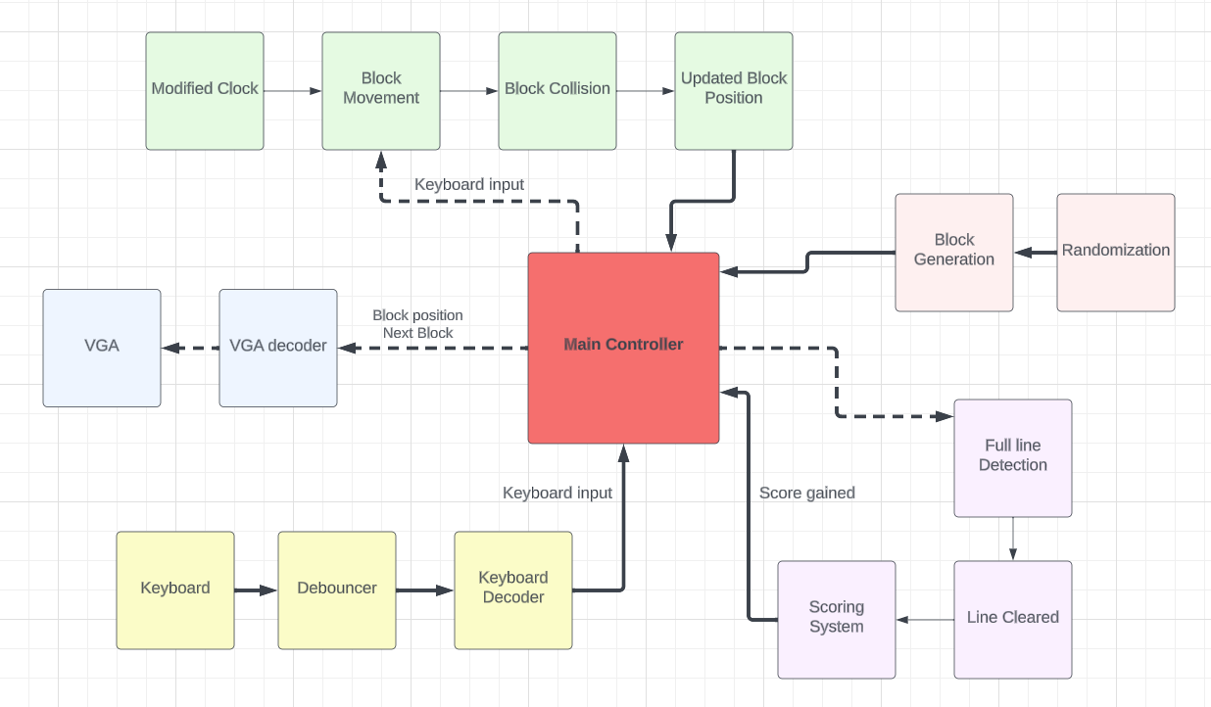
Block Diagram
Notes:
Hieu

Slide 7
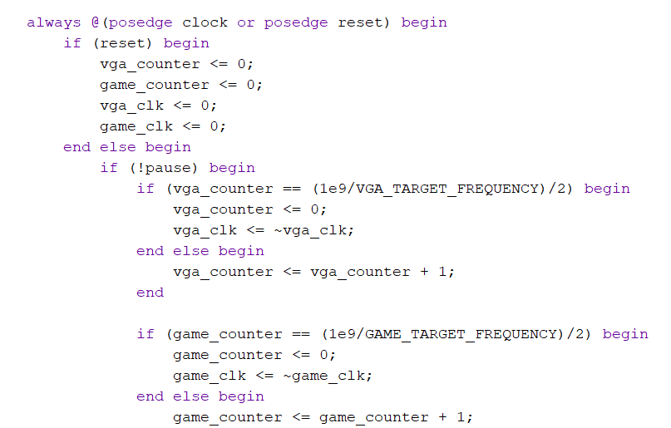
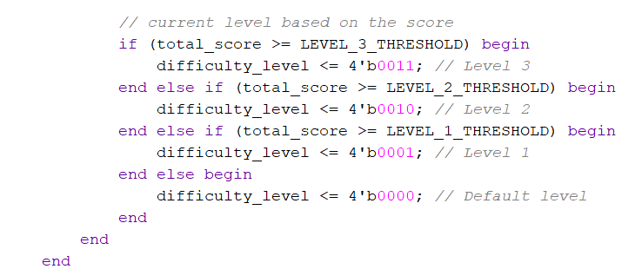
Code Snippets
Clock Divider that controllers the timing of our game logic by incrementing counters and toggling our clock based on specific conditions
Current Level is being shown based off the current players score
Notes:
Leah

Slide 8
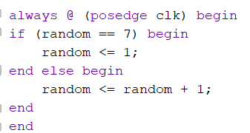
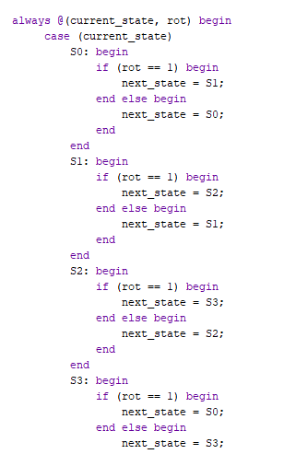
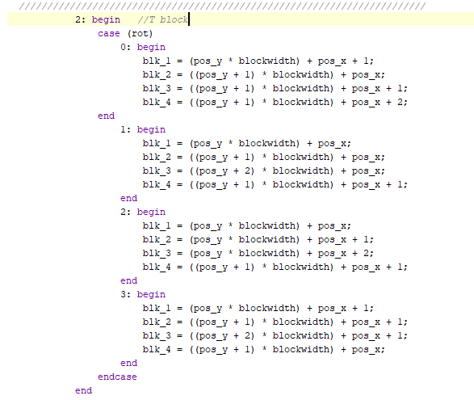
Additional Code
Generates “Random” Number 1-7
Shape Rotation Module which would get the position of each of the 4 blocks for each shape
FSM to keep track of rotation
Notes:
Carly

Slide 9
Successes
Ability to Look at Code from Previous Projects
https://github.com/jamih/EC311_SnowFall
VGA Working
Have sample code of pong working
Implements a block falling and collision detection
Keyboard Input from 4 Different Keys
Including debouncer
FSM to “count” how many times a piece has been rotated
Notes:
Sarah

Slide 10
Weaknesses
Creating a game requires many more modules than we initially realized
Collision detection is difficult
Variety of pieces (7)
Variety of orientations (4)
Use of VGA to create grid and display blocks
Give the user a preview of the next block if possible
Sprites?
Running out of time…
Notes:
Carly

